Slide 1
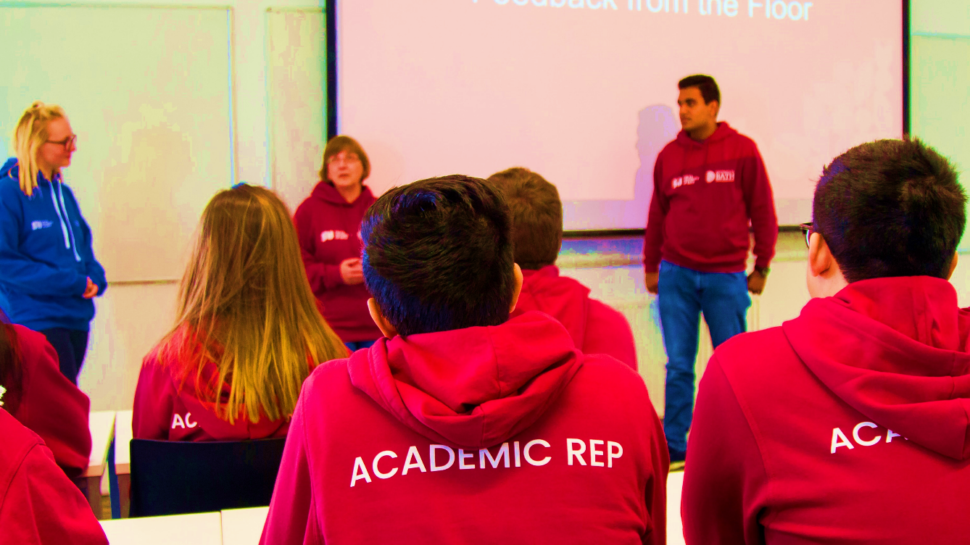
Academic Reps
Make real and positive change
thesubath
thesubath.com/academicreps

Slide 2
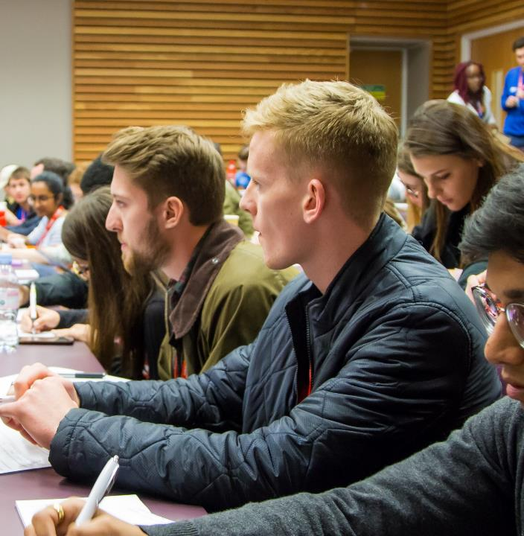
What is an Academic Rep?
They are key link between staff and students representing their cohort.
Proactively collect feedback from their cohort and work with Staff to resolve issues
Represent your feedback to staff members at all levels in key meetings such as Student Staff Liaison Committees.
thesubath
thesubath.com/academicreps

Slide 3
What are the benefits?
Develop key skills: communication, confidence, negotiation, problem solving, leadership, data collection and more
Insight and influence over how your course is managed and run. You have potential to lead on developing positive change through by working as team with your fellow reps, academic staff & SU
Get freebies and attend socials to thank you for your contribution towards the academic experience
thesubath
thesubath.com/academicreps

Slide 4
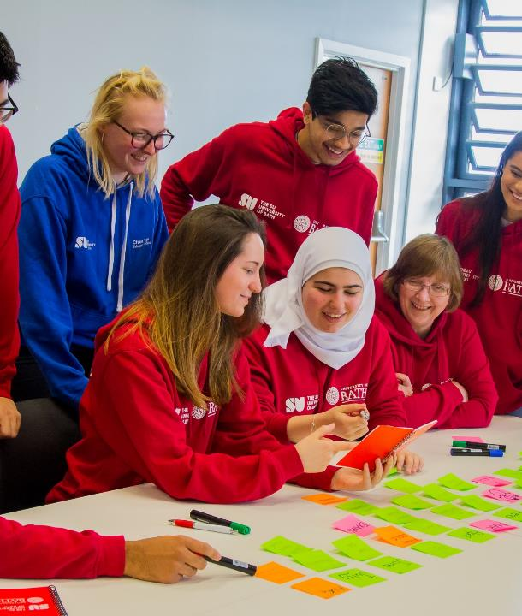
How do I become an Academic Rep?
1) Nominate yourself now!
  Nominations close: [DATE] at [TIME]
2) Get votes
  Voting opens: [DATE] at [TIME]
  Voting closes: [DATE] at [TIME]
Nominate and vote at:
thesubath.com/elections
thesubath
thesubath.com/academicreps

