Slide 1
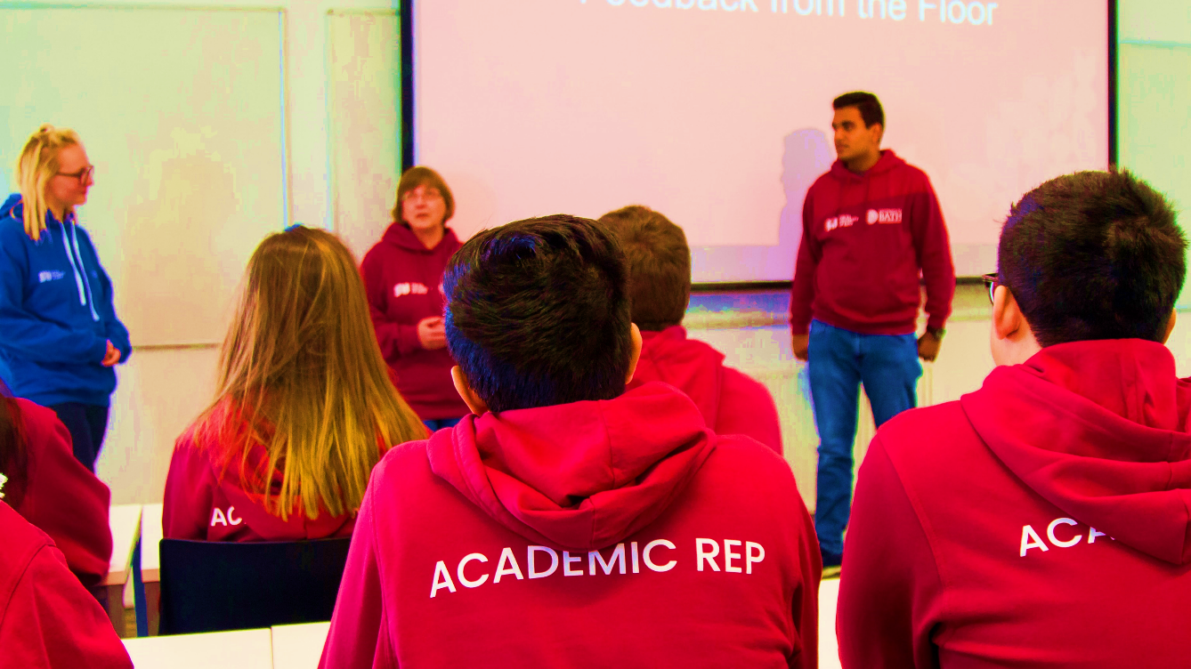
Doctoral Reps
Make real and positive change
thesubath
thesubath.com/academicreps

Slide 2
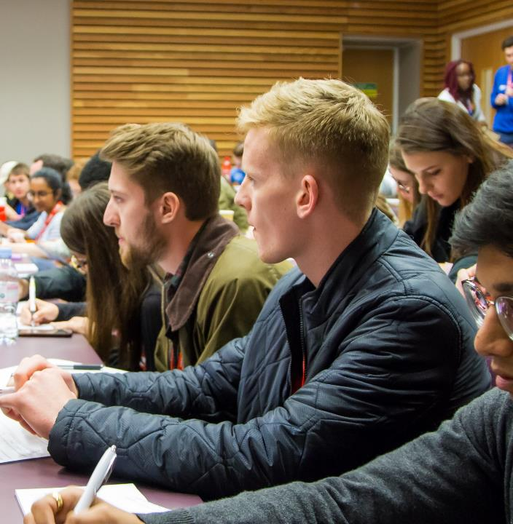
What is a Doctoral Rep?
They are key link between Doctoral staff and students.
Proactively collect feedback from their cohort and work with Doctoral Staff to resolve issues.
Represent your feedback to staff members at all levels in key meetings such as Student Staff Liaison Committees, SU Doctoral Council.
thesubath
thesubath.com/academicreps

Slide 3
What are the benefits?
Insight and influence over how your course is managed and run. You have potential to lead on developing positive change through by working as team with your fellow reps, academic staff & SU
Develop key skills: communication, confidence, negotiation, problem-solving, leadership, data collection, and more
Get freebies and attend socials to thank you for your contribution towards the academic experience
thesubath
thesubath.com/academicreps

Slide 4
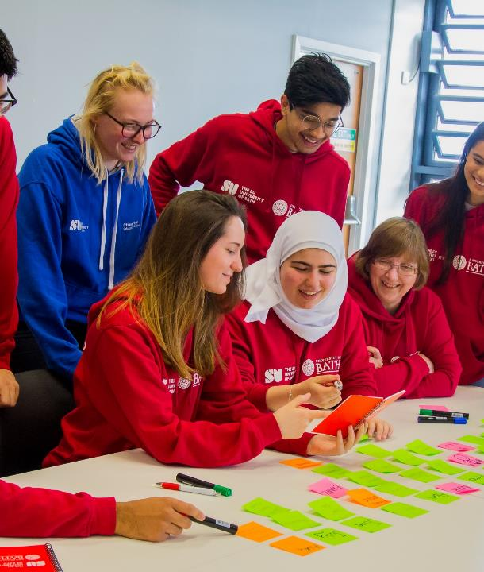
How do I become a Doctoral Rep?
1) Nominate yourself now!
  Nominations close: [DATE] at [TIME]
2) Get votes
  Voting opens: [DATE] at [TIME]
  Voting closes: [DATE] at [TIME]
Nominate and vote at:
thesubath.com/elections
thesubath
thesubath.com/academicreps

Slide 5
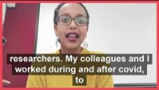
Why you should be an Academic Rep - Taghried (Doctoral)
https://youtu.be/SOLHA68lnTU
Notes:
https://youtu.be/SOLHA68lnTU

Slide 6
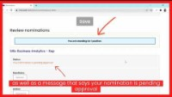
How to Nominate Yourself in an Election
https://youtu.be/HtIOayZImUg
Notes:
https://youtu.be/SOLHA68lnTU

