Slide 1
eXpense365 Training
2021/22

Slide 2
What is eXpense365?
eXpense365 is a new app that the SU use to allow students to make reimbursement claims from their groups.
It is an app that is calibrated for most smartphones, and can be found in your app store and downloaded.
eXpense365 should streamline the process of making claims within the SU and save a lot of paper by eliminating the need for some of the finance forms.
The app should make it easier and quicker to claim back your money.

Slide 3
When would I use eXpense365?
eXpenses365 can be used to claim reimbursement for costs you have incurred on behalf of your group, for example mileage claims when you have used your own car or refreshments you have purchased for an event.
eXpenses365 should only be used for low value claims and there is a maximum limit of £500.
It is good practice for clubs to impose their own lower limits to keep control of their finances.
We recommend £250 as a maximum limit.
(eXpense365 replaces the use of yellow forms for financial reimbursement claims, and green forms for mileage claims).

Slide 4
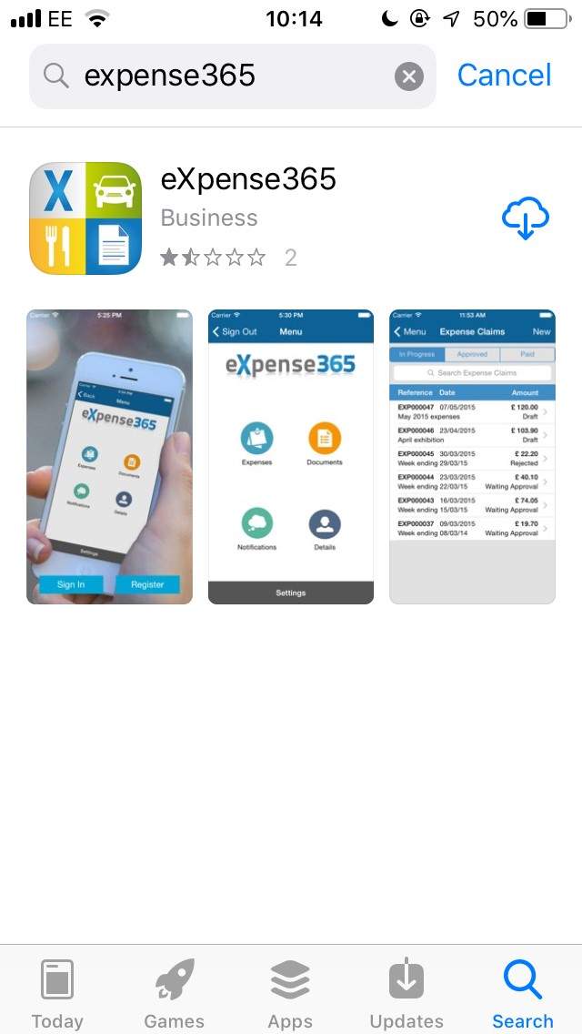
Downloading
eXpense365 is available for Apple and Android, on the app store.
Simply search for ‘expense365’, and you will be able to download it onto your device for free.

Slide 5
Push Notifications
If you are a Chair or Treasurer of a group, you will have been set up on the app as an authoriser and it is important to have push notifications enabled on the eXpense365 app, so that you don’t miss any claims that your members submit.

Slide 6
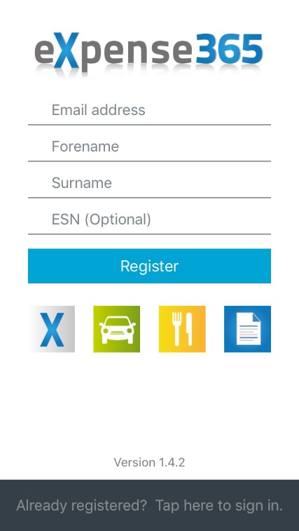
Registration
You’ll need to use your University email address to register and log in ( leave the ESN field blank).
The app is linked to the SU systems, so by using your university email address it will know automatically which groups you are a member of, making it quick and easy to make any finance claims.

Slide 7
Entering Your Details
It’s really important to make sure that ALL of your details are entered in your app.
It is very secure, so there’s no danger of your details being misused.
If all of these details are not filled in it could delay or prevent your claim going through the system.
Watch this video to show you an example.

Slide 8
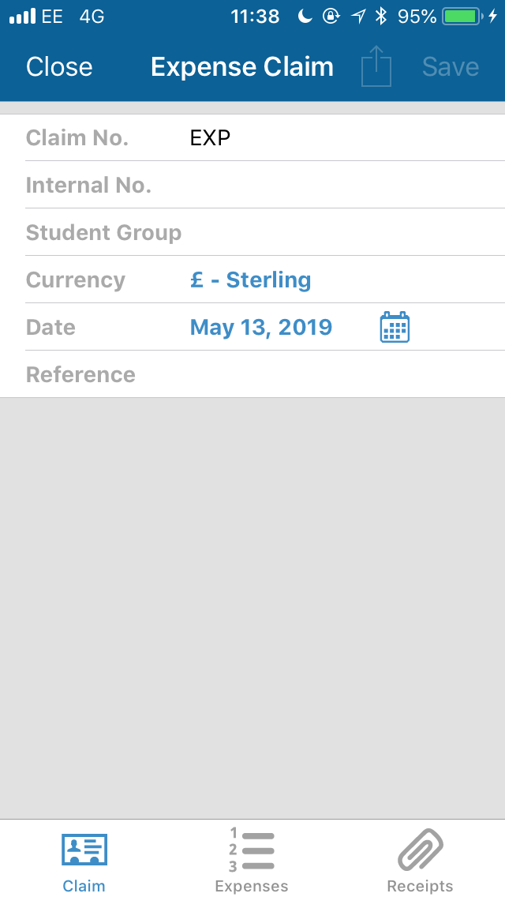
Making a Claim
If you are making claims to more than one group that you are a member of, you will need to do them separately.
Select the group you want to claim from (see coding manual here)
Leave the date as the day that you are making the claim
Put a reference for the claim (e.g. ‘decorations for social’)

Slide 9
Making a Claim
On this page you can add detail to your claim, and choose which expense code to charge it to.
The different expense codes will be labelled, and you just need to choose the one that matches your purchase (see coding manual here) .

Slide 10
Making a Claim
You will need to upload a receipt with your claim.
You can just snap a picture with your phone and upload it straight to the app!
Make sure that the amount shown in the receipt matches the amount that you are claiming.
You can upload more than one receipt per claim, so it’s best to combine your claims than do them all separately.

Slide 11
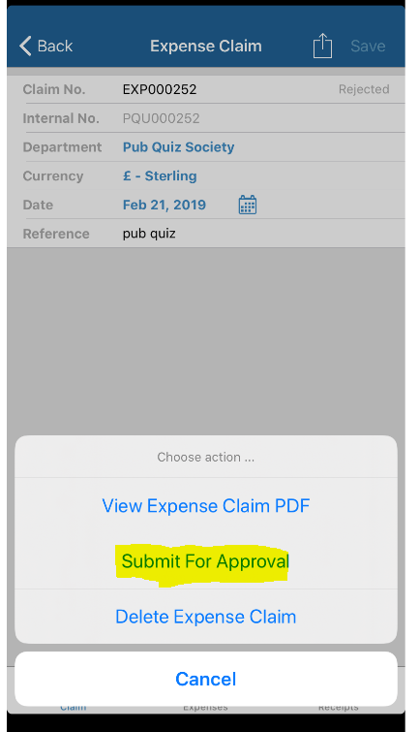
Submitting Claim
Once you have created your claim you need to submit the claim so it can be sent for approval by your Chair or Treasurer.

Slide 12
Authorising
If you are a Chair or Treasurer of a group you have been set up to authorise claims and you will receive a notification when someone in your group submits a claim.
You can either choose to approve the claim, or to reject it.
If you approve the claim, it will go through to the next level of authorisation, and then to payment.
If you reject the claim you can enter a reason why (e.g. ‘no receipts attached’) and the person who sent it in will have a chance to edit their claim and re-submit.

Slide 13
Viewing your balance- Chairs and Treasurers only
Chairs and Treasurers have access to the transaction listings in their group.
Click on ‘Documents’ on the home screen.
Here you will be able to look at all transactions into and out of your group’s account in the year.
Any queries on the transactions can be made to: sufinance@bath.ac.uk
Watch this video to show you an example

Slide 14
Any Questions?
If you have any questions about using the app to make a claim, view your balance or anything else in between please contact sufinance@bath.ac.uk
You can also look at the finance pages of the SU website at: Finance (thesubath.com)
Coding manuals can be found here;
Societies
Sports
Student Groups

