Slide 1
Law basics
2024

Slide 2
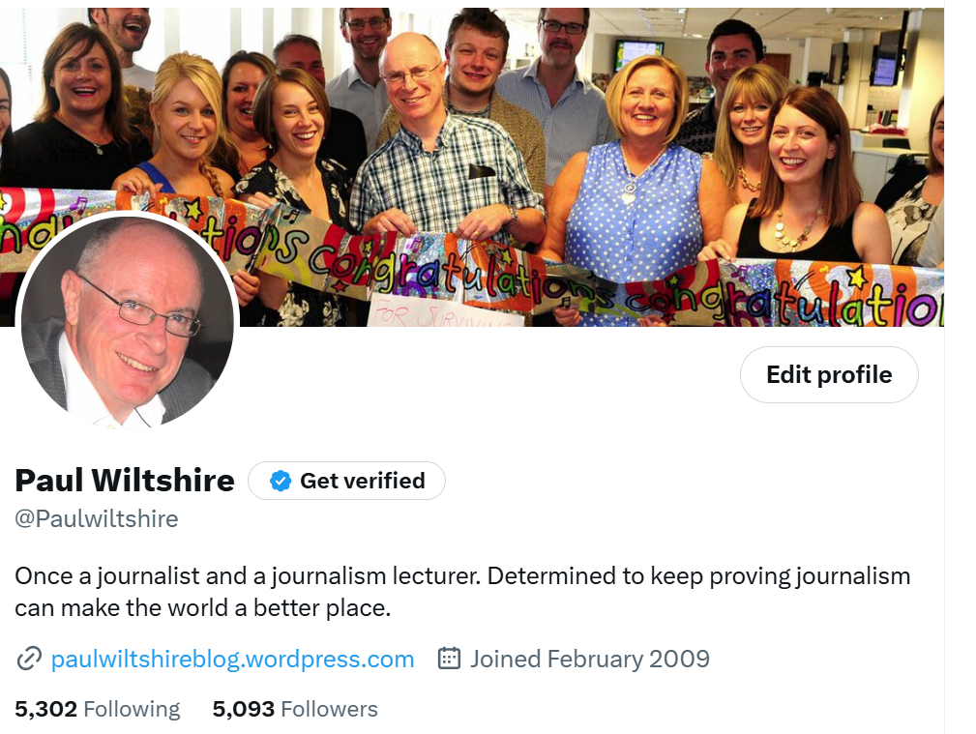
Who am I, who are you – and what will we be doing?
Accuracy, fairness and balance AND subjective vs objective reporting
Libel
Copyright
Privacy
Confidentiality
Freedom of Information
Restrictions: contempt, sex offences, young people
Elections
Media rights
Pwiltshire1963@gmail.com

Slide 3
Accuracy, fairness and balance
Why is all this important?
Legally – protection against libel actions
Ethically – maintain integrity, reputation, trust, credibility
Practically – complaints are time-consuming, damaging to relationships, and sap energy
Try putting yourself in the place of the person you’re writing about: how would you feel? Could you look them in the eye and justify every word you’ve written? Is your story entirely fair and balanced?

Slide 4
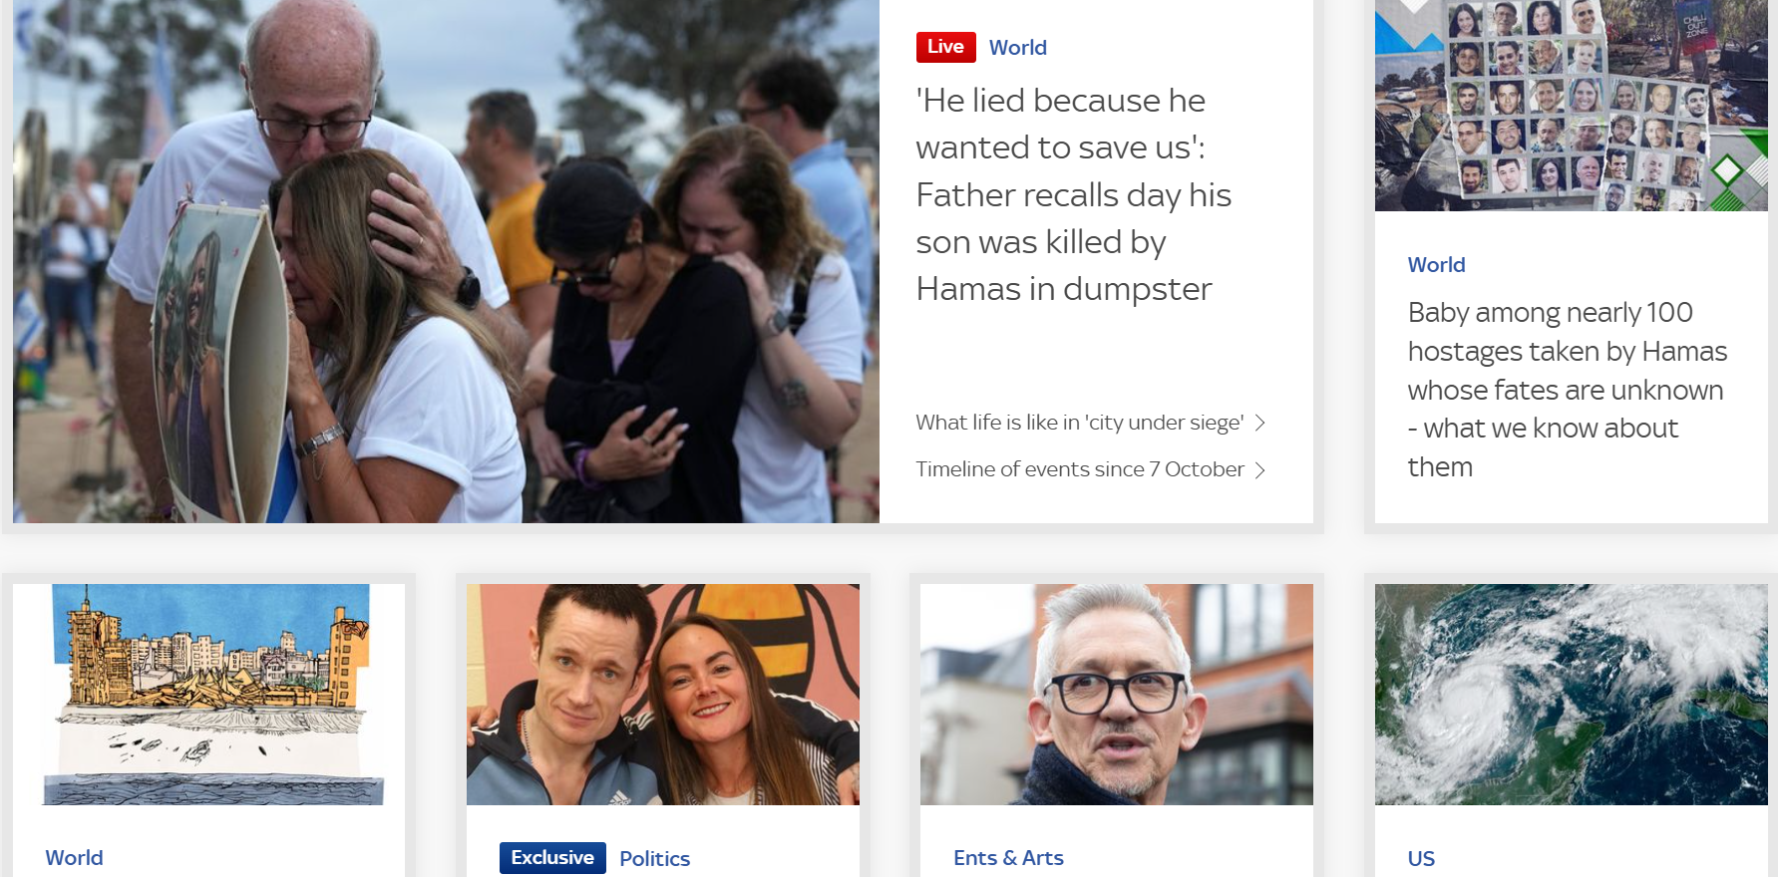
Objective reporting vs subjective comment

Slide 5
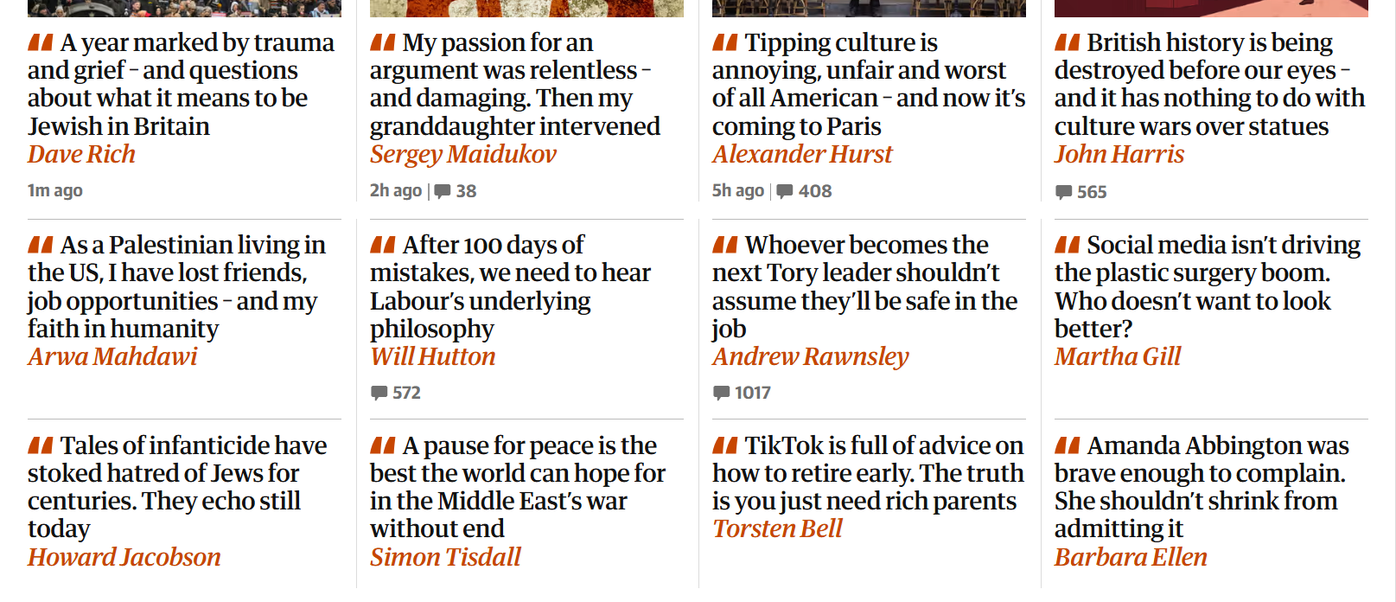
Objective reporting vs subjective comment

Slide 6
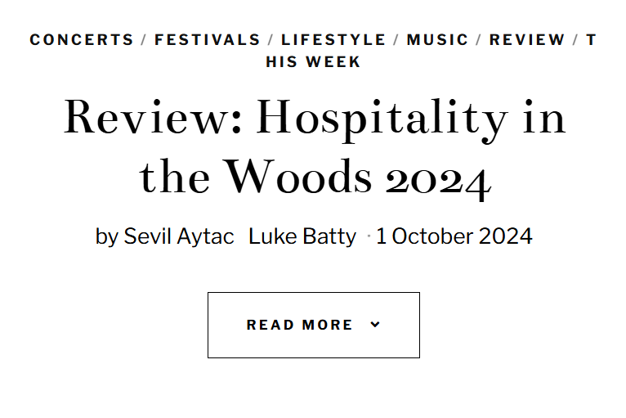
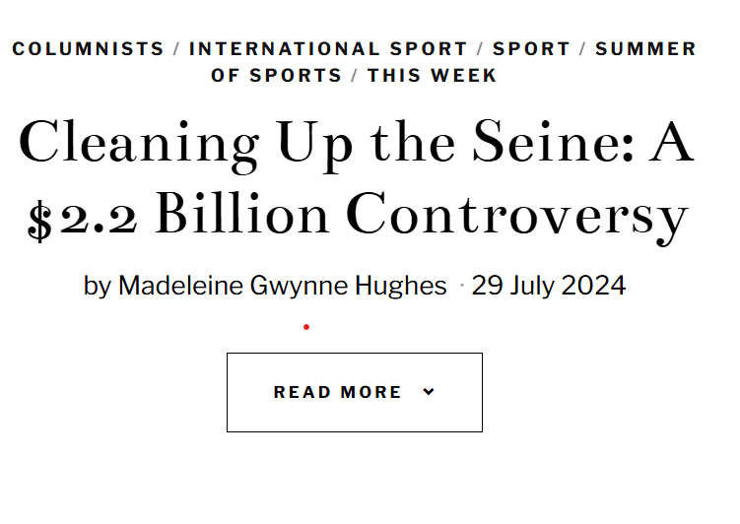
Objective reporting vs subjective comment

Slide 7
Objective reporting vs subjective comment
Objective
NEWS
FEATURES
Subjective
COMMENT
COLUMNS
REVIEWS
And how does that work for URB and Campus TV?

Slide 8
This is what all media law and ethics is about........
Freedom of expression
Protecting privacy/reputation/
vulnerable

Slide 9
Libel/defamation
The most common cause of libel action against media organisations is a journalist’s failure to apply professional standards of accuracy and fairness – McNae’s Essential Law for Journalists

Slide 10
Libel
What is libel/defamation? A statement which could....
Expose person to hatred, ridicule or contempt
Cause person to be shunned or avoided
Lower person in estimation of right-thinking members of society
Disparage person in business, trade, office or profession
PLUS Must cause serious harm

Slide 11
Libel
Legal action – the proof
Defamation exists
Identification – it may be reasonably understood to refer to person
Publication to a third person – tweet seen by just 65 people = publication
Applies to print, radio, TV, film, video, online and plays.

Slide 12
Identification
IS THE LIMIT …..
IF A LIBELLOUS DESCRIPTION APPLIES TO FEWER THAN 30 PEOPLE, YOU MAY HAVE LIBELLED ALL OF THEM
You don't have to NAME someone to identify them

Slide 13
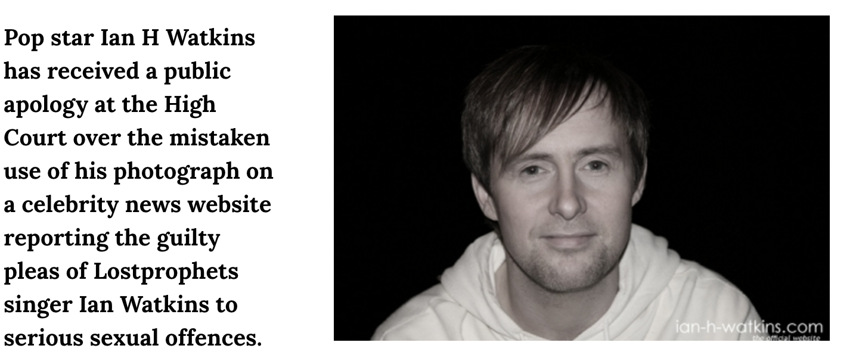
Identification
Take care also over juxtaposition: generic/stock pix or video next to story about specific individual

Slide 14
Libel
Defences
Truth
Privilege – absolute and qualified; right to reply
Online comments – innocent publication
Honest opinion

Slide 15
Libel – the truth defence: Plebgate
Truth defence: being able to prove what you reported was true, on the balance of probabilities

Slide 16
ANd this one...

Slide 17
And this one
Rebecca Vardy sued Coleen Rooney over allegations she leaked private info to media – and lost

Slide 18
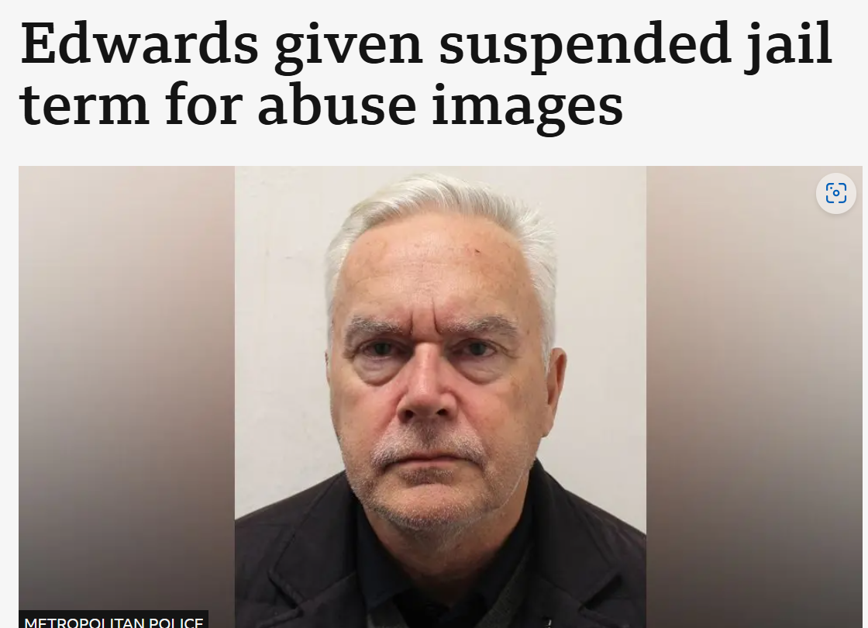
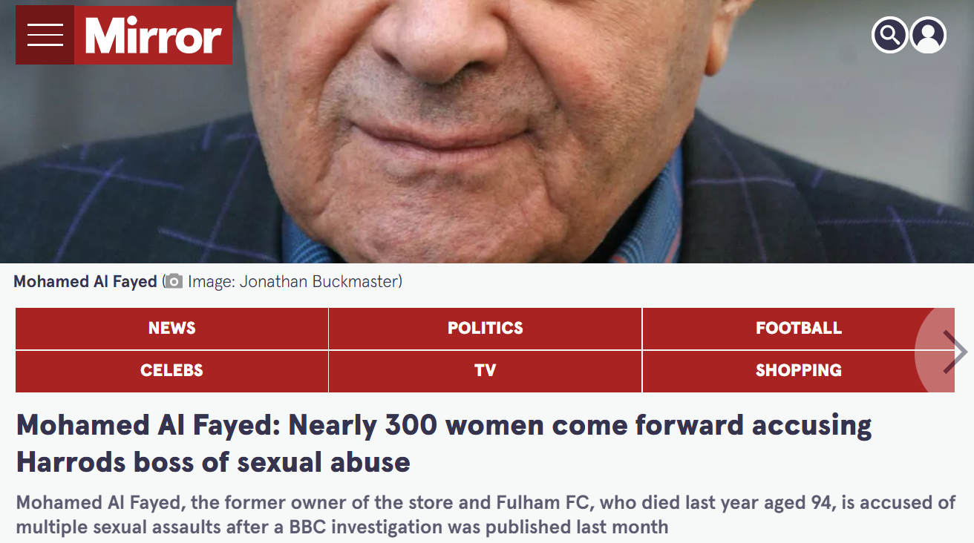
And what about these?
Accuracy
Libel
Contempt
Privacy
Sex offence victims
You can't libel the dead

Slide 19
Privilege
Remember: no privilege before press conference if you’re sent speech/what will be said in advance; no privilege for leaked, unofficial documents; no privilege for off-the-record information from official sources; no privilege for response statements
Qualified privilege
Council meetings and documents
Legal documents
Government reports
Public meetings
Parliament
Official statements
Press conferences
Must be fair and accurate, without malice and in the public interest
In most cases, must allow right to reply – explanation or contradiction (not protected by privilege)

Slide 20
Qualified privilege: SU and sports bodies would be covered

Slide 21
What do you need to do here?
A takeaway in Oldfield Park used by thousands of students has been given a zero rating. How can you cover this safely?

Slide 22
What do you need to do here?
What if the takeaway owner said: "This is hugely unfair. The kebab place next door has a 5 rating because the council is taking bribes from the bloke that runs it. I'm being victimised."

Slide 23
And here…....?
At the annual general meeting of the SU, the elected executive in charge of sport launches a furious attack on the uni rugby club, accusing it of encouraging sexism, dangerous levels of drinking and anti-social behaviour.
What do you need to do?

Slide 24
Accuracy – public interest
“Journalists should always try to put defamatory or damaging allegations to the subject if they intend to report them in the public interest.”
McNaes Essential Law for Journalists
ALWAYS: keep your notes/recordings of interviews; keep an audit trail of efforts to get responses

Slide 25
Libel question
“We’ve totally transformed the pub. When we took over it was a right dump, and very poorly-run. We’ve got rid of all the under-age drinking now and it’s a different place,” said new pub landlord Fred Bloggs.
What would you need to take out?

Slide 26
Defamation: web comments
Publisher protected by Section 1 of Defamation Act 1996 against action over defamatory statements made by members of public; strengthened by Section 5 of Defamation Act 2013; also protection from Regulation 19 of the EU’s Electronic Commerce Regulations
Regulation 19 protection means publisher/operator must act ‘expeditiously’ to correct/remove material, or to disable public access when told about comment
1996 Act says publishers must take ‘reasonable care’ over material written/posted by anyone other than editor, author or publisher; this may mean that if website moderates comments before publication, libel may succeed; it means they have to remove or correct libellous material quickly

Slide 27
Libel – alarm bells
Secondhand information – is it true? More importantly, can you prove it? Do I have a defence?
Use of file pix to illustrate stories, and juxtaposition; make sure you use the right headshot
Quoting opinions – ‘it’s him saying it, not us’
‘Allegedly’ isn’t enough
Anything to do with alcohol, or finances
Anything that questions the integrity or professionalism or professional ability of someone with a reputation to defend

Slide 28
Libel: honest opinion

Slide 29
Libel – honest opinion
Applies to comment pieces – not factual reporting
Must be honestly-held, or capable of being held by honest person in possession of the facts
Must be labelled as opinion – restaurant review, theatre review, column etc
Comment must be based on a provable – and indicated - fact
Doesn’t have to be fair – but be careful about attacking character and integrity of identifiable people

Slide 30
Honest opinion
“[an allegation of dishonesty] is not thought to be a matter of opinion: nor can one convert an allegation of dishonesty (or, for that matter, of murder or rape) into a matter of opinion by merely inserting in front of it a formula such as “I believe …” or “she thinks …””
JUDGE SIR DAVID EADY
Magazine forced to pay £1.4m damages in 1994 after suggesting a new yacht made by Walker Wingsail Systems failed to live up to the manufacturers’ claims, and that the firm was misleading buyers. The couple who ran the firm claimed they were being accused of being liars.
Key factor: Criticism went beyond product to question character and integrity of identifiable people

Slide 31
Honest opinion
Column accused Sir James Dyson of 'screwing the country'
Dyson claimed this was 'highly distressing personal attack'
Judge said no financial harm done, and no allegation of dishonesty
"...the scope for honest comment, however wounding and unbalanced, was very considerable indeed."

Slide 32
Honest opinion
Media lawyer Jo Vale

Slide 33
Honest opinion: GIG REVIEW
The main problem with this performance was that lead singer Jack Dawe's voice just isn't strong enough.
I agree with the reaction on Twitter: you just couldn't hear him. The nerves had clearly got to him.
If this band is going to stand any chance of success in the future, they need to dump jittery Jack and find a new front person.

Slide 34
Honest opinion: GIG REVIEW
The main problem with this performance was that lead singer Jack Dawe's voice just isn't strong enough.
I agree with the reaction on Twitter: you just couldn't hear him. The nerves had clearly got to him.
If this band is going to stand any chance of success in the future, they need to dump jittery Jack and find a new front person.
And another thing. The band's management is accountable here, too.
They knew Jack wasn't up to it, and yet they pushed on with the gig, effectively taking money under false pretences.
That to me is fraud, pure and simple.

Slide 35
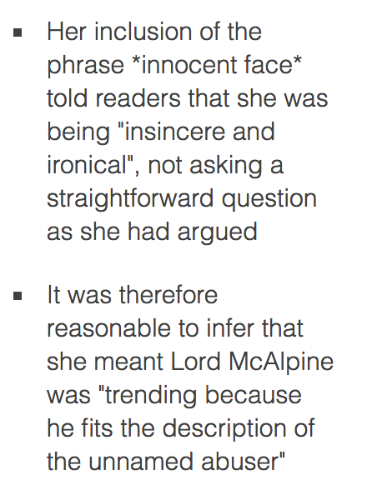
Social media dangers/innuendo
Mr Justice Tugendhat, High Court, 2013
"Why is Lord McAlpine trending. *innocent face*."

Slide 36
Libel serious harm case – Jack Monroe vs Katie Hopkins
Hopkins asked Monroe on Twitter if she had ‘scrawled on any memorials recently’
Hopkins deleted tweet but refused to apologise
Said she had mixed Monroe up with columnist Laurie Penny
Judge Mr Justice Warby said tweets
‘have a tendency to cause harm to this claimant’s reputation in the eyes of third parties, of a kind that would be serious for her’
Hopkins ordered to pay £24k damages and £107k costs – and no appeal
https://www.theguardian.com/media/2017/mar/10/jack-monroe-wins-twitter-libel-case-against-katie-hopkins

Slide 37
Other libel cases
Elton John won damages from Sun over story claiming he and David Furnish showed no concern over attack by their dog on a child
Earl Spencer won damages from Mail over story that he acted in “unbrotherly, heartless and callous way” towards sister Princess Diana
Members of Pussycat Dolls sued Mail over story saying group was a ‘prostitute ring’ where they were ‘passed around for sex’
Tory MP Ben Bradley apologised and paid money to charity after tweeting that Jeremy Corbyn had sold secrets to Eastern European spies

Slide 38
Key questions to ask
Is what I’m writing defamatory?
If so, do I have a defence?

Slide 39
What is copyright?

Slide 40
What does copyright cover?
Written articles
Poetry
Lyrics
Books
Plays
Scripts
Photos
Maps
Paintings and drawings
Databases
Listings
Music
TV and radio output
Movies
Timetables
Website designs
Typographical arrangement of published editions

Slide 41
How long does copyright last?
Text, music, artistic work and photos – 70 years after death of creator/author/photographer
Computer-generated music/graphics – 50 years from creation
Sound – 70 years from when first recorded
Broadcast – 50 years from when made

Slide 42
Copyright – the law
Who owns copyright? – pre-1989, the default position (or first owner) is whoever commissioned a picture or piece of work; post-1989, the default position is whoever took it or wrote it
Copyright can be assigned (in writing), and copyright for employees’ work rests with their employer
Even if a photographer has legal copyright, people in pictures can sue for breach of moral rights under section 85 of Copyright, Designs and Patents Act 1988 if photos are used for purposes other than ‘private and domestic’ – ie in stories re tragedies etc

Slide 43
Getting permission – Images
Use of copyrighted material may be permitted – or licensed
May get permission to use for free, with a credit, or with payment
If in doubt: don’t use – or seek permission
Best practice: take your own
Submitted pictures for entertainment coverage – check whether the photographer needs a credit or wants payment
Check publicly-available pictures on council websites – cost one paper £3k (down from £10k)

Slide 44
Social media
Pictures from sites such as Facebook, Instagram and Twitter will be copyright of whoever took them, and possibly of the sites themselves
Embedding Tweets is fine, as is using pictures that have been tweeted to us, or which we have sought permission to use
Screenshots probably ok and YouTube embeds probably ok

Slide 45
Safe use of photos
Search for pictures labelled for reuse – non-commercial in your case at the moment
Otherwise Google Images are subject to copyright
Creative Commons licences may insist that work isn’t commercial

Slide 46
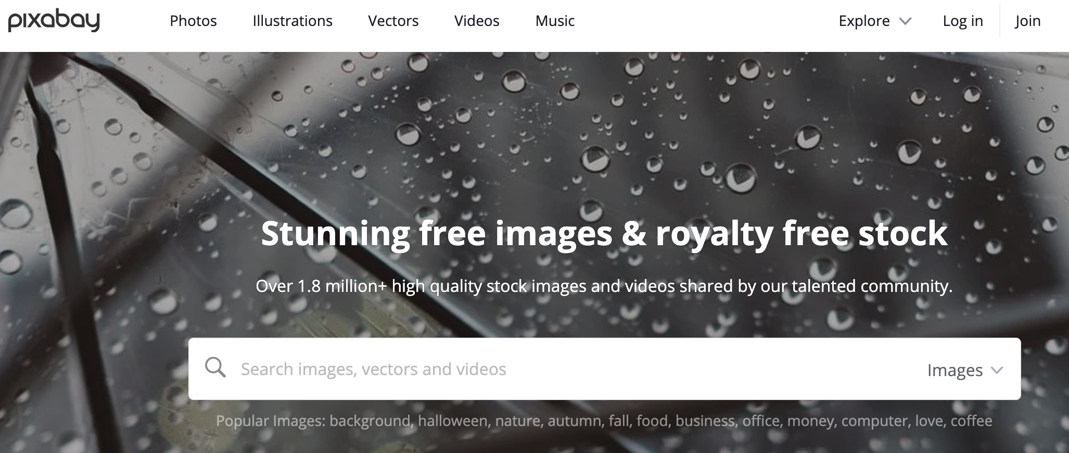
Safe use of photos

Slide 47
Coping with copyright – text and video
No copyright in facts, news or information, but there is copyright in the way in which they’re used – ie sentences, listings. Rewriting will be needed.
‘Fair dealing’ reinforced by the 2014 Copyright, Designs and Patents Act allows the copying of some quotes, provided there is attribution – known as ‘sufficient acknowledgement’
Problems with copying ‘any substantial part’ of a story and quotes, with the law saying it should be ‘no more than is necessary for the purpose’
Fair dealing also covers use of video clips
Embedding video usually safe
No fair dealing defence for photos – unless in reviews

Slide 48
Music copyright*
Using music available in the Instagram app looks safe
No fair dealing defence as such – even for non-profit organisations
https://about.instagram.com/blog/announcements/updates-and-guidelines-for-including-music-in-video
https://help.instagram.com/354736791367645/how-can-i-make-sure-that-the-content-i-post-to-instagram-doesn%27t-violate-copyright-law%3F/?helpref=related_articles&source_cms_id=126382350847838
https://www.alphr.com/add-music-instagram/
I'm not an expert on this

Slide 49
To summarise....
TEXT/QUOTES/VIDEO/AUDIO:
Attribute: say where the material has come from
Use sparingly
Don't need to ask for permission
PICTURES:
Need to get permission
Crediting the source isn't enough

Slide 50
privacy
Regulators and the law generally agree on locations where there is an expectation of privacy:
Home, back garden
Restaurants, clubs – unless can be clearly seen through window
Private beaches
PLUS there are situations where there is expectation of privacy:
Health moments: mental health crisis eg suicide attempt, ambulance treatment
Family occasions: unofficial trips to events, shopping trips
Privacy may be breached to expose hypocrisy or lying where there is public interest

Slide 51
Privacy and social media
IPSO questions to ask:
How personal is the material?
What is the public interest?
Has the person tried to restrict access?
Did they upload it themselves?
Is it appropriate/likely to increase distress?

Slide 52
Privacy and social media
IPSO/PCC rulings:
Ok to use innocuous image from publicly-accessible website of dead person (but could be copyright issue)
Ok to report statements made on Facebook if in the public interest – police officer’s flippant ‘My lot have murdered someone again. Sh*t happens’ message over G20 protest death. Goble vs Sunday People
Ok to report Twitter comments if not of intimate nature and even if there’s the usual disclaimer – DoT civil servant Sarah Baskerville vs Independent on Sunday and Mail over ‘hungover at work’ Tweets
Ok to use group pictures eg shoppers, without permission
OK to use material from public tribute Facebook pages

Slide 53
confidentiality
Confidential documents won't have privilege protection against libel
Law can stop media using documents which ought to be confidential
BUT: Public interest defence if they show an organisation is lying or misleading the public

Slide 54
Contempt – the basics
Take care when writing about an incident where someone has been arrested, or – more importantly – charged
Particularly dangerous when it's a serious crime likely to be dealt with at crown court in front of a jury
No-nos: previous convictions, evidence, character information
OK: common ground, passive phraseology
Who, when and where: Likely to be safe
What, why and how: Likely to be dangerous
Innocent until proven guilty

Slide 55
Juveniles – the basics
Basic rule of thumb is that anyone under 18 involved in a court case should be anonymous: defendant, victim, witness
What does this mean? Size of locator, don’t put in descriptions of family, physical characteristics, disability, sporting abilities etc
Jigsaw identity – how to avoid

Slide 56
Sex offences – THE basics
Lifelong anonymity for alleged victims/victims of sexual offences from the moment allegation is made
Care over locators, scenesetters, descriptions eg student, barmaid – only has to identify her to some people, jigsaw ID
Wide range of offences – including incitement, trafficking, exposure
Waiving anonymity – in writing, 16 or over, freely given

Slide 57
Freedom of Information Act 2000
Gives people the right to require public authorities to disclose information they wouldn’t otherwise publish
Includes government departments, councils, universities, schools, NHS
Authorities have 20 working days to respond
Can refuse because of exemptions and cost
If refuse, internal appeal, then appeal to Information Commissioner’s Office, and to Information Tribunal

Slide 58
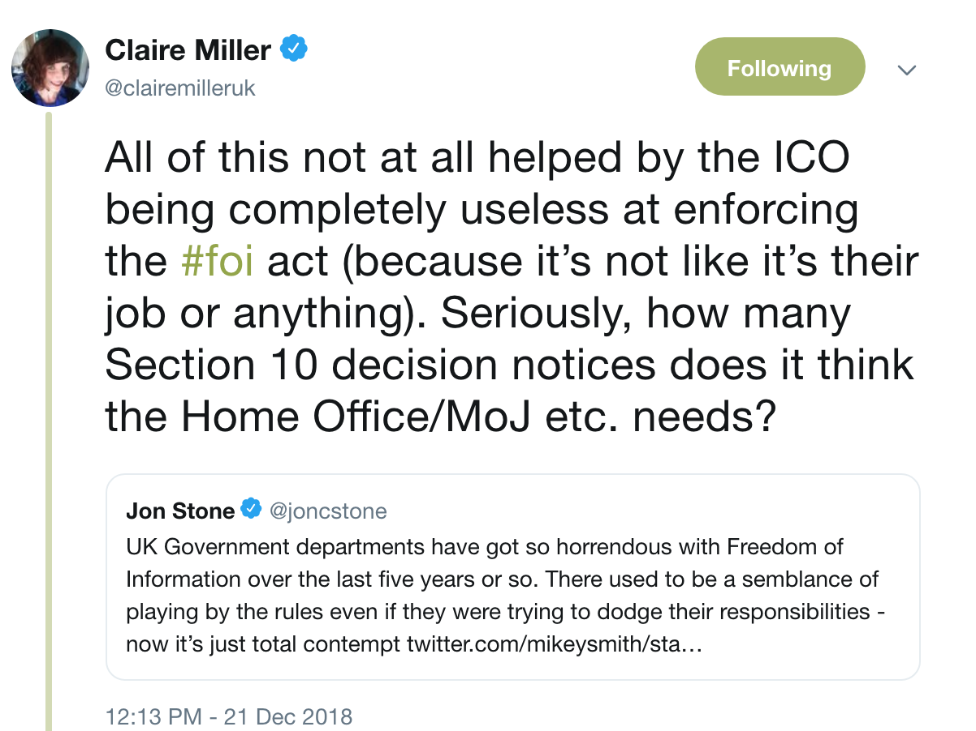
Freedom of Information Act tips
Look at https://www.whatdotheyknow.com/ http://clairemiller.net/blog/2013/01/a-great-big-list-of-foi-ideas/ and http://www.foiman.com/
https://davidhiggerson.wordpress.com/2017/06/04/foi-friday-stories-made-possible-thanks-to-the-law-politicians-keep-trying-to-kill/amp/
https://medium.com/behind-local-news-uk/local-democracy-reporting-making-the-most-of-foi-9aebb010238a
https://medium.com/behind-local-news-uk/how-a-simple-foi-request-resulted-in-having-to-appear-in-court-1a0b496e2638
Search for Freedom of Information on websites
Look at bodies’ disclosure logs
Make sure you target the right body
Ask for correspondence
Challenge if a body seems to be blocking you
Ask what information a body holds on a subject so you know what to request
Be specific

Slide 59
Freedom of information
Authorities can refuse applications if:
Requests are vexatious or similar to previous ones
Finding the information is too costly – more than £600 for govt body, more than £450 for other authorities
Personal information
National security – absolute exemption for organisations such as MI5
Court records – absolute exemption
Information provided in confidence
Information due to be published in future
Many other exemptions
YES
Network Rail
Academies
MAYBE
Royal family – some exemptions
BBC – some exemptions
NO
Utility firms, rail companies

Slide 60
Election law
Could we run a vox pop on election day revealing how people voted?
Illegal to report how people have voted on the day of an election – while polls still open

Slide 61
Media rights
You are taking pictures of a protest on public land outside a chemical plant when a security guard persuades a PC to ask you to stop filming because ‘you don’t have permission.’ He threatens to seize your phone.
What do you do?
Remember: areas open to the public aren’t always public land eg railway stations, shopping centres, universities

Slide 62
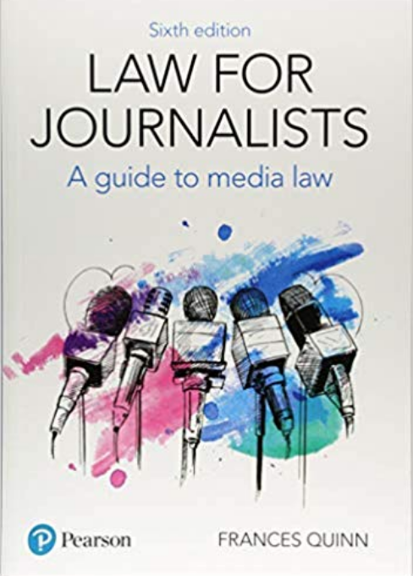
Think about getting one of these

Slide 63
Any questions?

